Slide 1
Application layer

Slide 2
Domain Name System
Name space:
the names must be unique because the addresses are unique.
Two types
Flat name space
Hierarchical name space

Slide 3
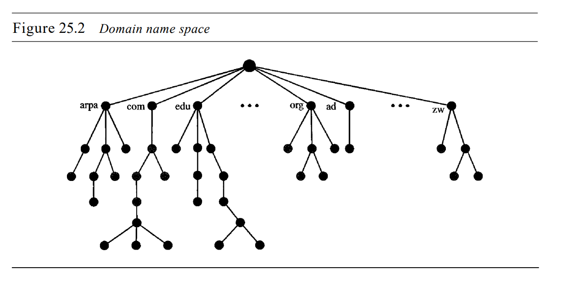
Hierarchical name space
The tree can have only 128 levels: level 0 (root) to level 127

Slide 4
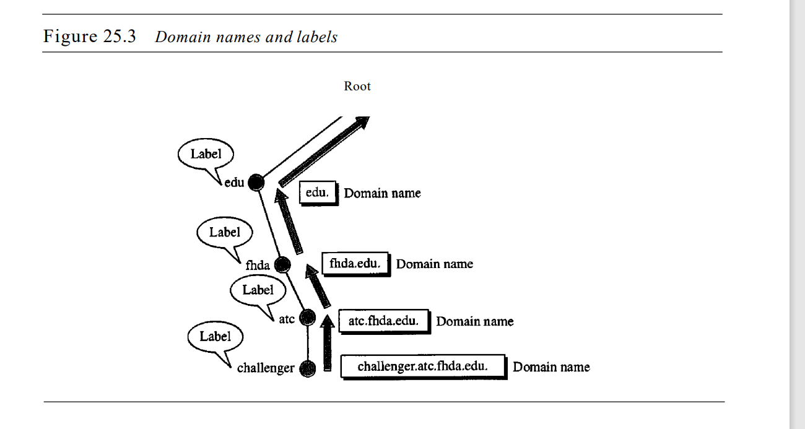

Slide 5
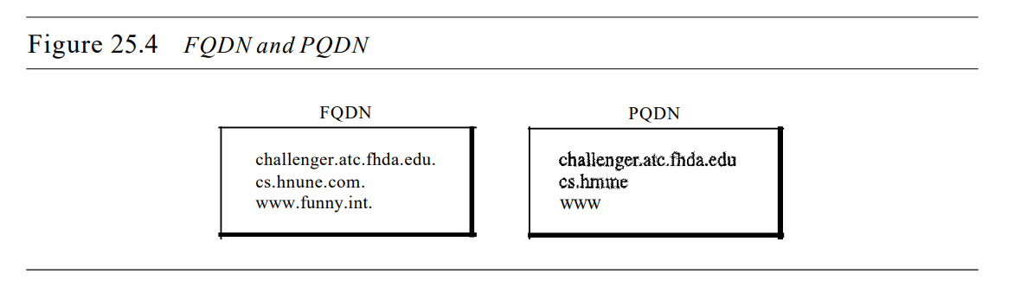
FQDN, PQDN
Fully Qualified Domain Name
Partially Qualified Domain Name

Slide 6
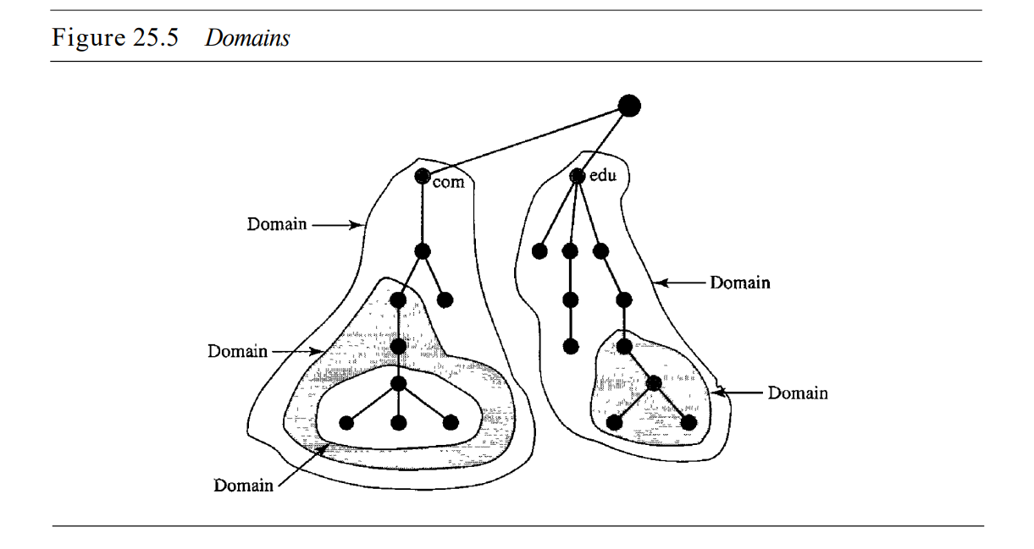
DOMAIN
A domain is a subtree of the domain name space. The name of the domain is the domain name of the node at the top of the subtree.

Slide 7
DISTRIBUTION OF NAME SPACE
The information contained in the domain name space must be stored.
It is very inefficient and also unreliable to have just one computer store such a huge amount of information.
It is inefficient because responding to requests from all over the world places a heavy load on the system.
It is not unreliable because any failure makes the data inaccessible.
The solution to these problems is to distribute the information among many computers called DNS servers.

Slide 8
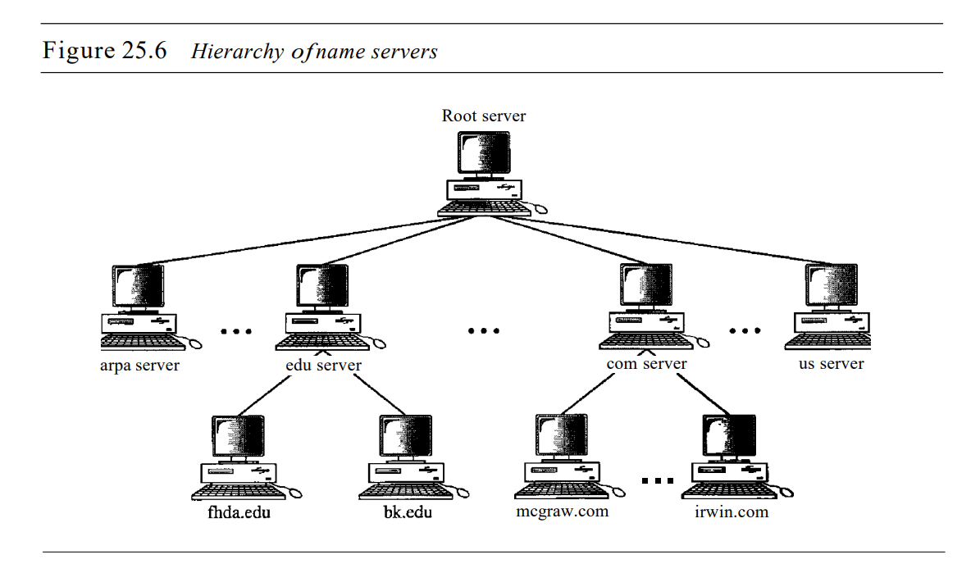
DNS allows domains to be divided further into smaller domains (subdomains).
Each server can be responsible (authoritative) for either a large or a small domain.
hierarchy of servers

Slide 9
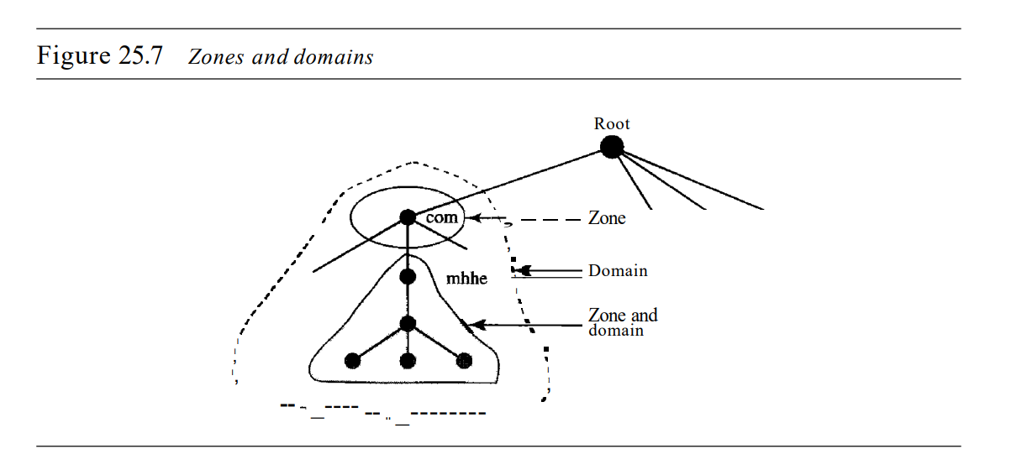
Zone
a server is responsible for or has authority over is called a zone.
The server makes a database called a zone file and keeps all the information for every node under that domain.

Slide 10
Primary and Secondary Servers
A primary server is a server that stores a file about the zone for which it is an authority. It is responsible for creating, maintaining, and updating the zone file
The secondary server neither creates nor updates the zone files. If updating is required, it must be done by the primary server, which sends the updated version to the secondary.

Slide 11
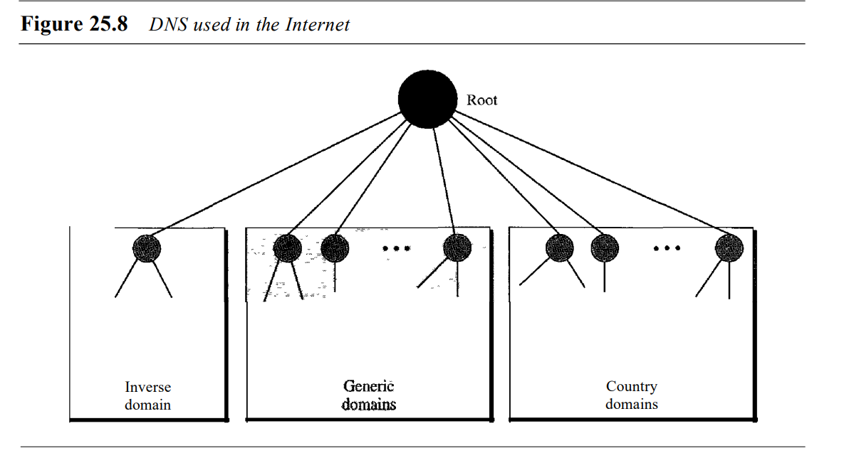
DNS IN THE INTERNET

Slide 12
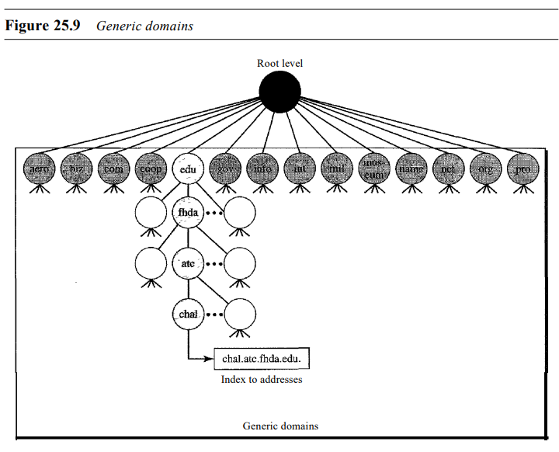
Generic Domains
Generic domains Country domains The generic domains define registered hosts according to their generic behavior. Each node in the tree defines a domain, which is an index to the domain name space database

Slide 13
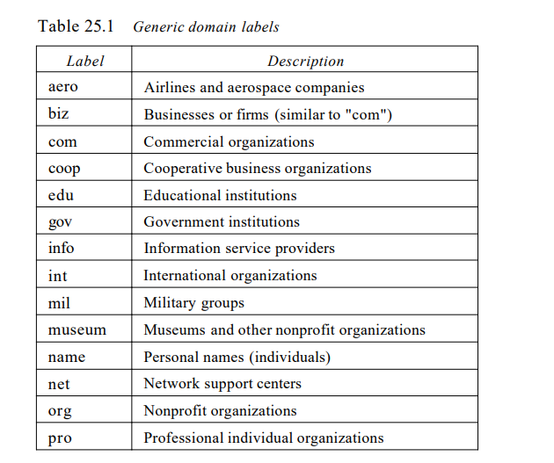

Slide 14
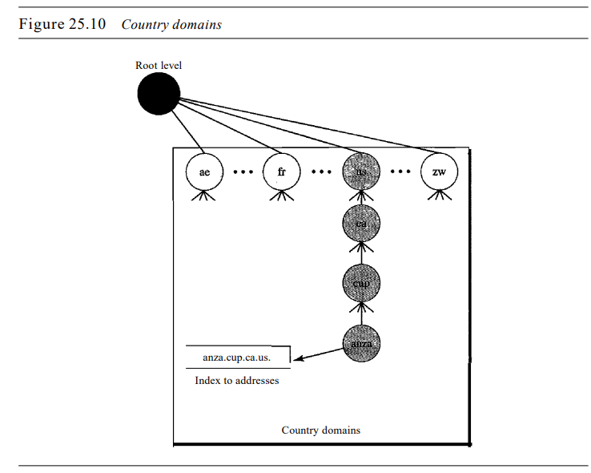
Country domains
The country domains section uses two-character country abbreviations (e.g., us for United States)

Slide 15
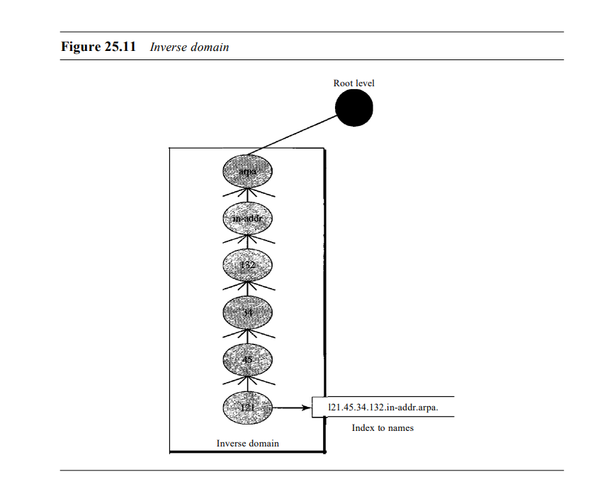
Inverse domain
The inverse domain is used to map an address to a name.
This may happen, for example, when a server has received a request from a client to do a task.
Although the server has a file that contains a list of authorized clients, only the IP address of the client (extracted from the received IP packet) is listed

Slide 16
Working
Steps of traverse
Client
Cache
Resolver
Root server(nearly 13 sets all over the world)
Top level domain server
Authoritative name server
Resolver

Slide 17
